Slide 1


REVOLUTIONIZING FINANCIAL DECISION-MAKING Development Of an Intelligent Stock Trader Platform SOLFINTECH

Slide 2

Table of contents
INTRODUCTION
MACHINE LEARNING (System) PRINCIPLES AND CONCEPTS
PREPROCESSING
THE SYSTEM PROCESS OF DEVELOPMENT
CHALLENGES
MODEL EVALUATION AND PROCESS OF DEVELOPMENT (STOCK CHART)
SYSTEM DEMO

Slide 3

INTRODUCTION
A well-known multinational in the financial industry, Solent Financial Technology (SOLFINTECH) is an expert in managing savings and investments in addition to trading stocks and shares. The company has more than 50 million customers on its online investing platform, which manages more than 150 billion pounds in assets. Known for its safe trading methods, SOLFINTECH is present on several stock exchanges, such as the FTSE 100 and different equities markets. Preparing to launch the Intelligent Stock Trader (IST) platform, the firm is responding to the growth of rival fintech startups and its large clientele. By purchasing stocks from FTSE listed businesses and other securities at discounted rates and selling them when prices rise, this sophisticated technology is intended to execute transactions intelligently. In addition, it is anticipated that the IST platform would be able to predict stock and equity price fluctuations on a daily, weekly, monthly, and even quarterly basis.

Slide 4
MACHINE LEARNING PRINCIPLES AND CONCEPTS (SYSTEM BASED)
The creation of the Intelligent Stock Trader (IST) platform demonstrated how machine learning concepts might be applied effectively, with a focus on the importance of feature engineering, data preparation, and model selection. To guarantee data quality and consistency—a need for trustworthy model predictions—cleaning, normalization, and encoding were necessary first steps in the data preparation process. Feature engineering optimized the input for machine learning models by extracting and generating significant variables from the raw data, thereby augmenting the system's predictive power.
Forecast for the Stock
Time Series Analysis: To spot patterns and trends over time, machine learning algorithms can examine past stock market data, including price movements, trade volumes, and macroeconomic variables. Recurrent neural networks (RNNs) and autoregressive integrated moving average (ARIMA) models are two-time series analytic approaches that may be used to predict future stock values based on historical performance.
Sentiment analysis: News articles, social media messages, and other textual data about stocks and companies may be analyzed using Natural Language Processing (NLP) approaches. The general sentiment (positive, negative, or neutral) reflected in various sources may be evaluated by sentiment analysis algorithms, which then use this data as an input feature in stock prediction models. While negative sentiment may portend future downturns, positive sentiment may reflect an optimistic view of the market.

Slide 5
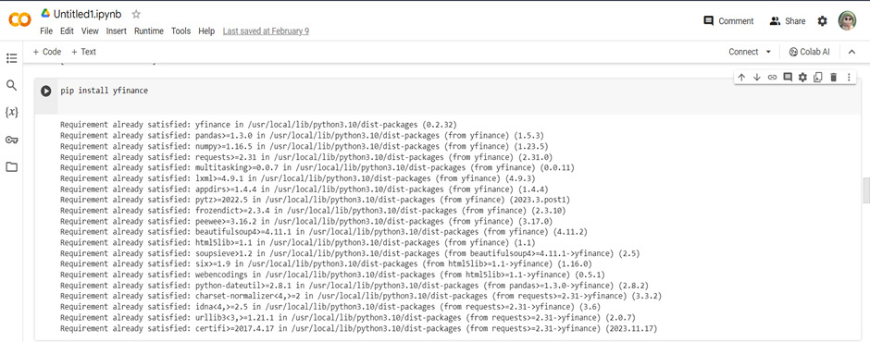
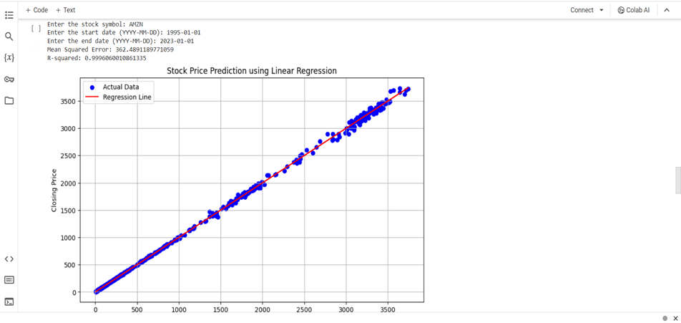
Preprocessing is an essential stage in preparing raw data for detailed analysis, which is particularly important for forecasting the stock market. Preprocessing addresses issues such as missing information and inconsistent pricing scales by transforming past financial data into a more precise and organized format. Additionally, it adds calculated features to the mix, including moving averages, to give a more comprehensive picture. This careful planning guarantees that the data I feed into my model for my project—which involves making a stock prediction chart—is comprehensible, useful, and unambiguous. Because of this, it not only makes fundamental stock market patterns more understandable but also improves my model's capacity to forecast future movements by taking advantage of the complex interactions between different market indicators.
PREPROCESSING

Slide 6
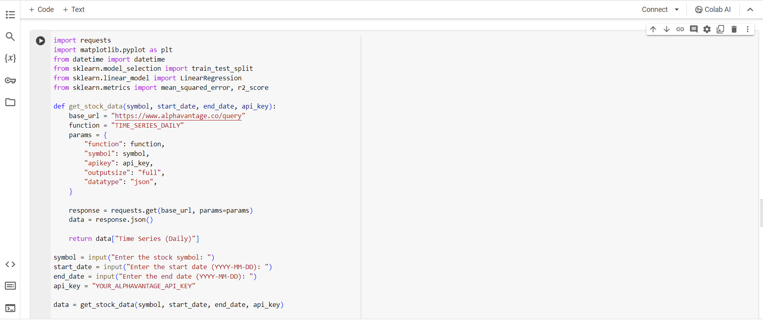
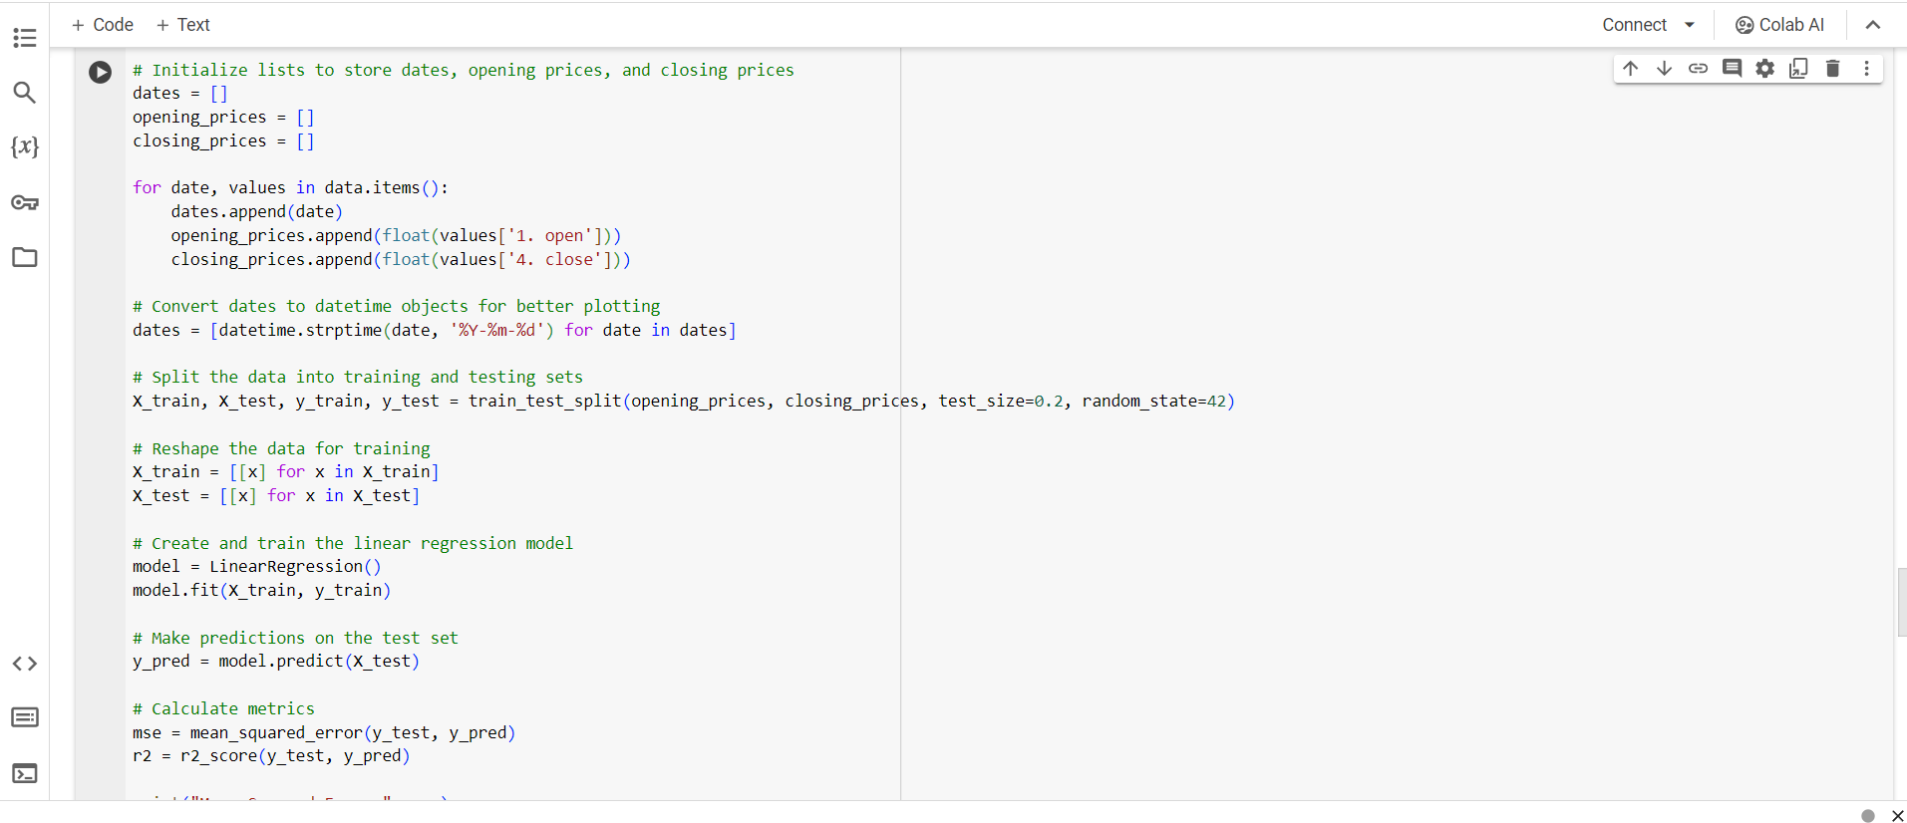
MODEL SELECTION AND DEVELOPMENT
STOCK PREDICTION USING LINEAR REGRESSION
Using linear regression to predict stock prices allows machine learning to interpret financial market patterns. This approach uses linear regression to establish a direct link between past stock prices (input variables) and future prices (output variable) to simulate this relationship. It assumes that historical stock data, such as volumes and prices, can linearly predict future values. The method uses the slope and intercept of the best-fitting line to anticipate changes in stock prices while minimizing prediction errors. Although the simplicity of linear regression provides a straightforward starting point for financial research, the intricate world of the stock market may not always support linear regression's premise of linearity. However, it offers fundamental knowledge that opens the door to more complex prediction models and advances comprehension of market dynamics.

Slide 7
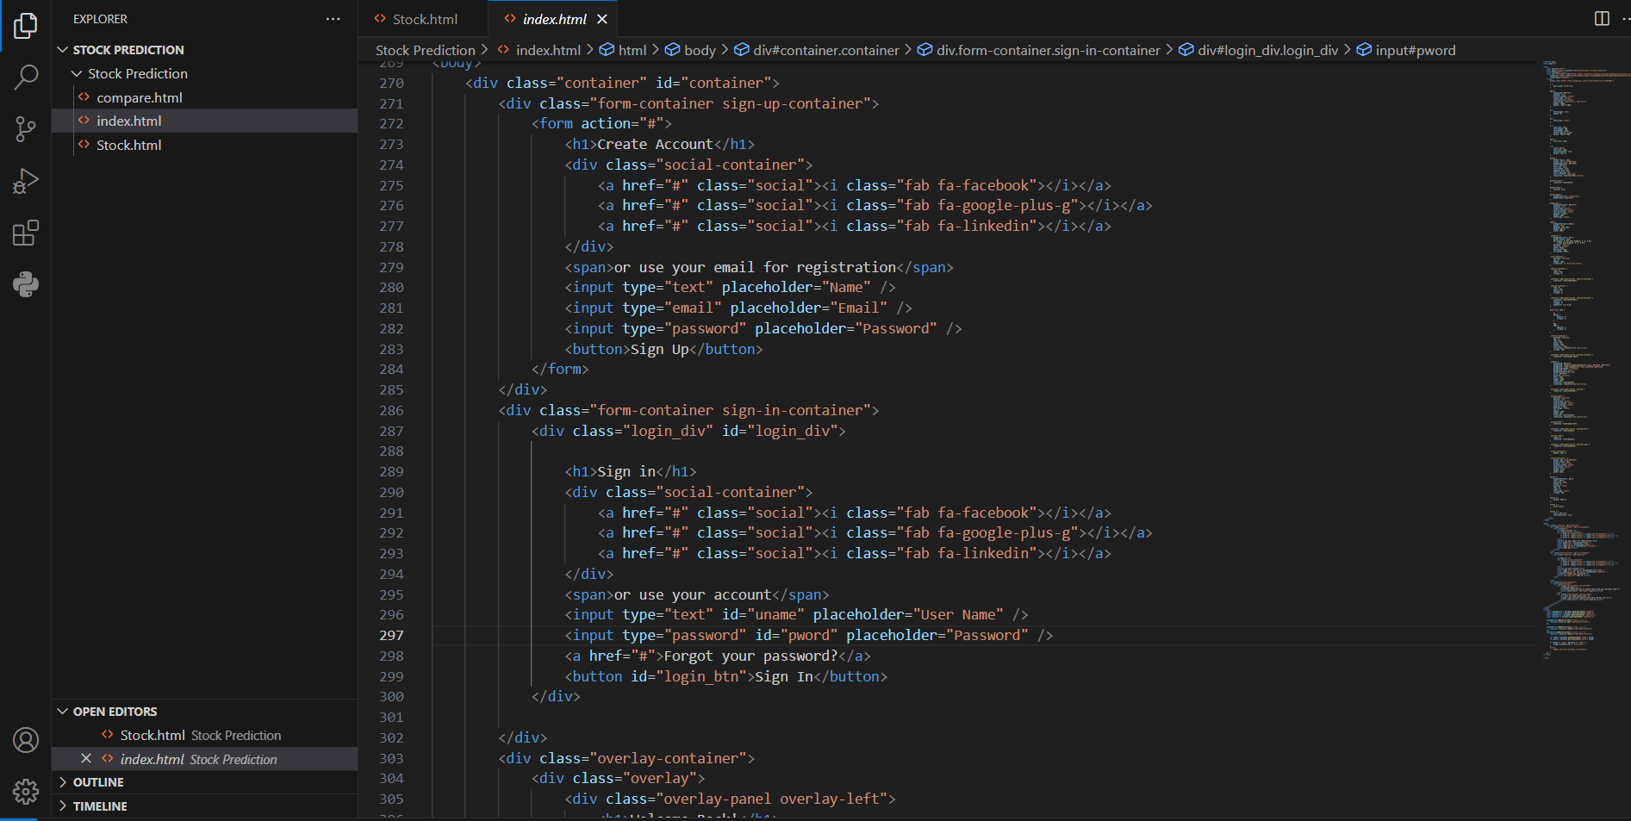
THE SYSTEM PROCESS OF DEVELOPMENT
Explain front-end development
The Stock Price Prediction Dashboard is crafted using HTML, CSS, JavaScript, Ajax, and Scatter, offering an intuitive platform for visualizing financial data. When a stock symbol is entered, a backend request is sent to Alpha Vantage for historical data. This data is then examined using a Linear Regression model to predict future values. The user interface, which is characterized by its beauty and simplicity, includes interactive components such as data input forms and a submission button. All of this culminates in a dynamic graphical display of past and anticipated stock values, driven by Chart.js. This elegant combination of backend logic and front-end design guarantees a seamless user experience, giving investors insightful information about stock market patterns and supporting them in their decision-making.

Slide 8
CHALLENGES TO DEVELOPING STOCK CHART
Data Quality: Poor data quality can lead to inaccurate models. Solutions include data preprocessing techniques, data cleaning, and feature engineering.
Bias and Fairness: Machine learning models can perpetuate biases present in the training data. Mitigation strategies involve careful dataset selection, algorithmic fairness techniques, and regular model audits.
Interpretability: Black-box models can be difficult to interpret, leading to a lack of trust. Techniques such as model-agnostic interpretability methods and transparent model architectures address this issue.
Scalability: As datasets grow larger, scalability becomes a challenge. Distributed computing frameworks and efficient algorithms help in scaling machine learning systems.
Privacy and Security: Protecting sensitive data is crucial. Privacy-preserving techniques like differential privacy and secure multi-party computation safeguard data while allowing meaningful analysis.
Data Gathering and Utilization: Acquiring a sizable volume of high-quality data that corresponds to the desired forecast. To illustrate the sophistication of your system, this entails selecting data from many stock exchanges and making sure it covers a variety of firms or securities with detailed pricing data.

Slide 9
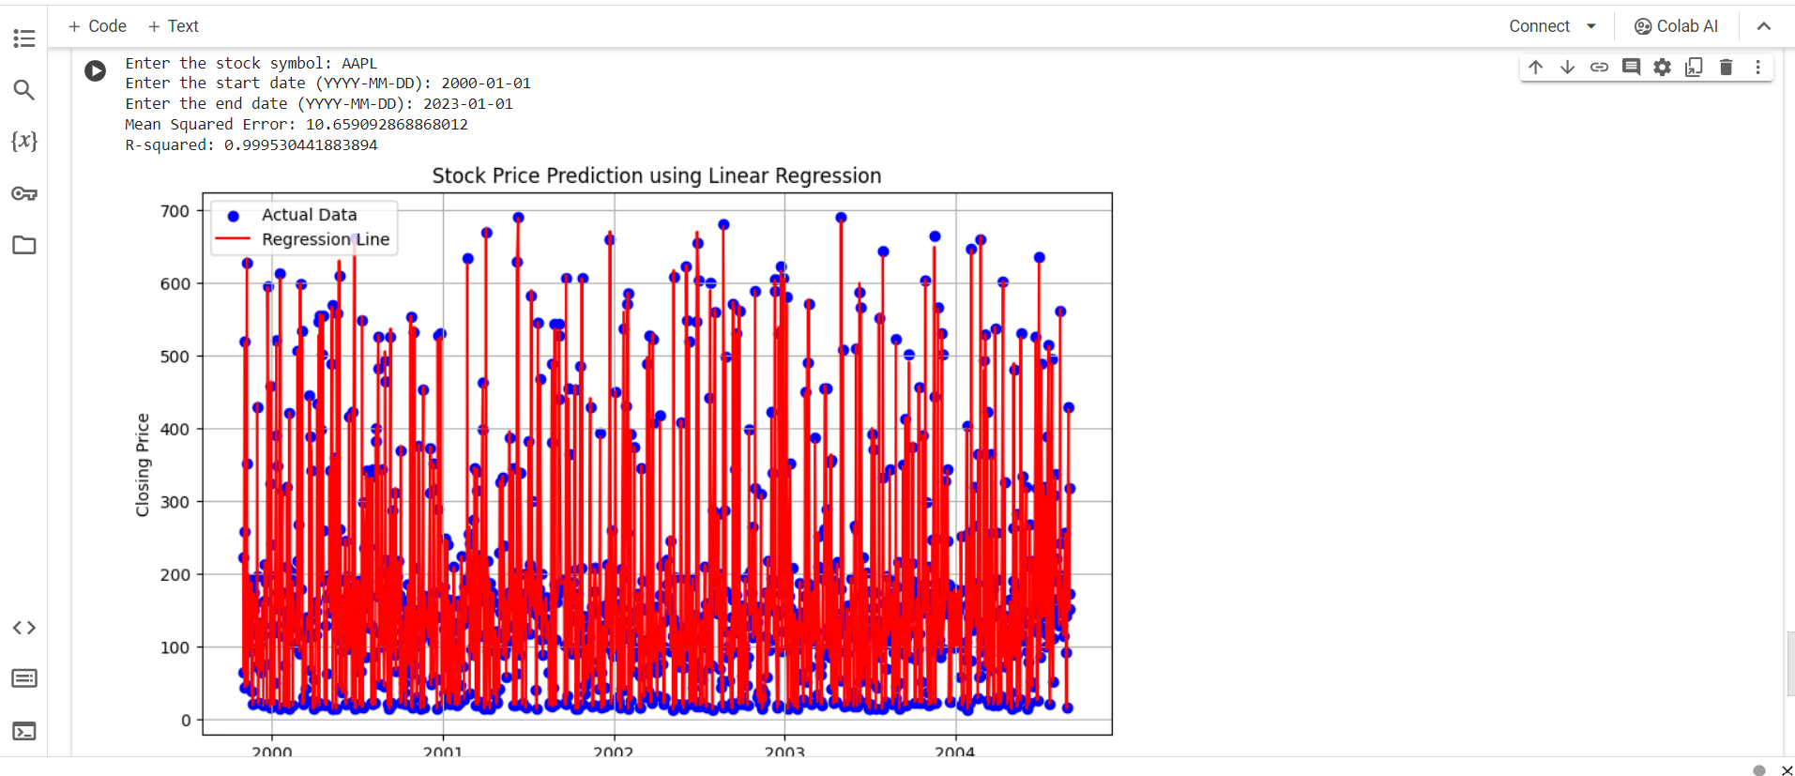
MODEL EVALUATION AND PROCESS OF DEVELOPMENT (STOCK CHART)
The efficacy and precision of the machine learning models in forecasting stock prices were the main subjects of the Intelligent Stock Trader (IST) platform's examination and findings. To calculate the system's prediction accuracy %, real-world data was compared to the system's predictions during the assessment phase. For example, the actual market data of the next day was compared with the system's forecast from the previous day, and similar comparisons were done for weekly and monthly projections. This method offered a quantifiable indicator of the prediction accuracy and dependability of the system.

Slide 10
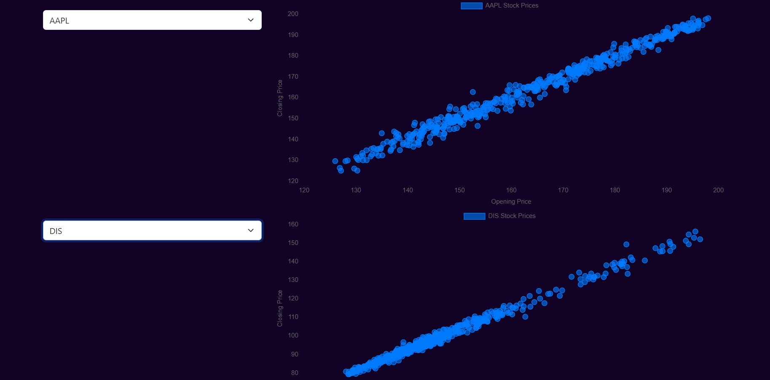
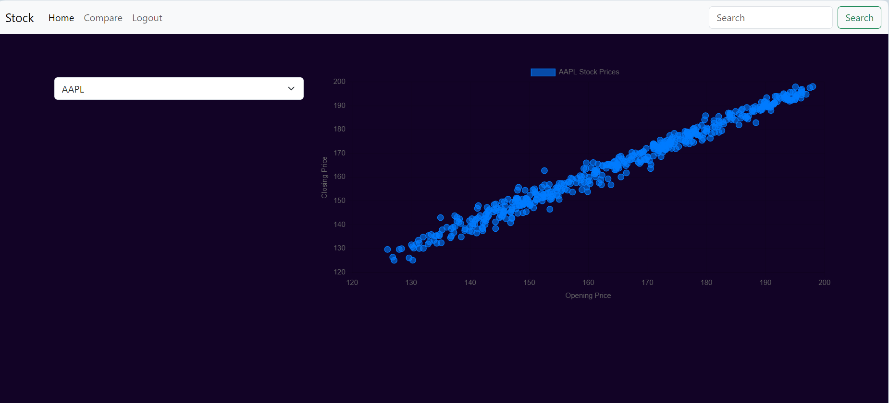

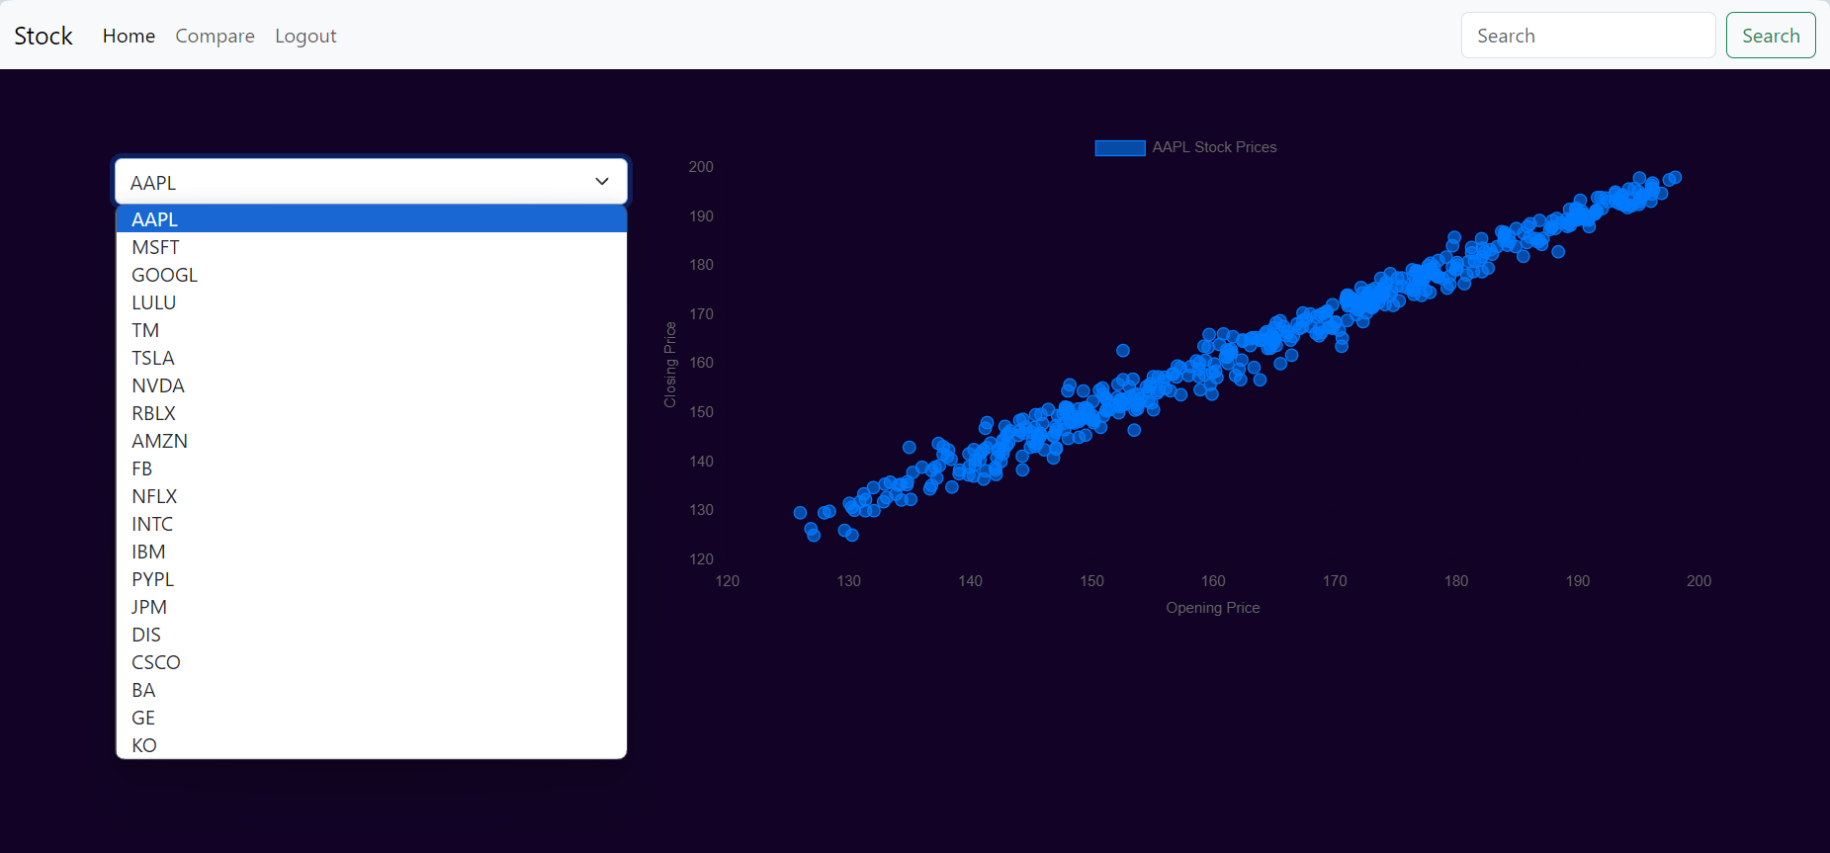
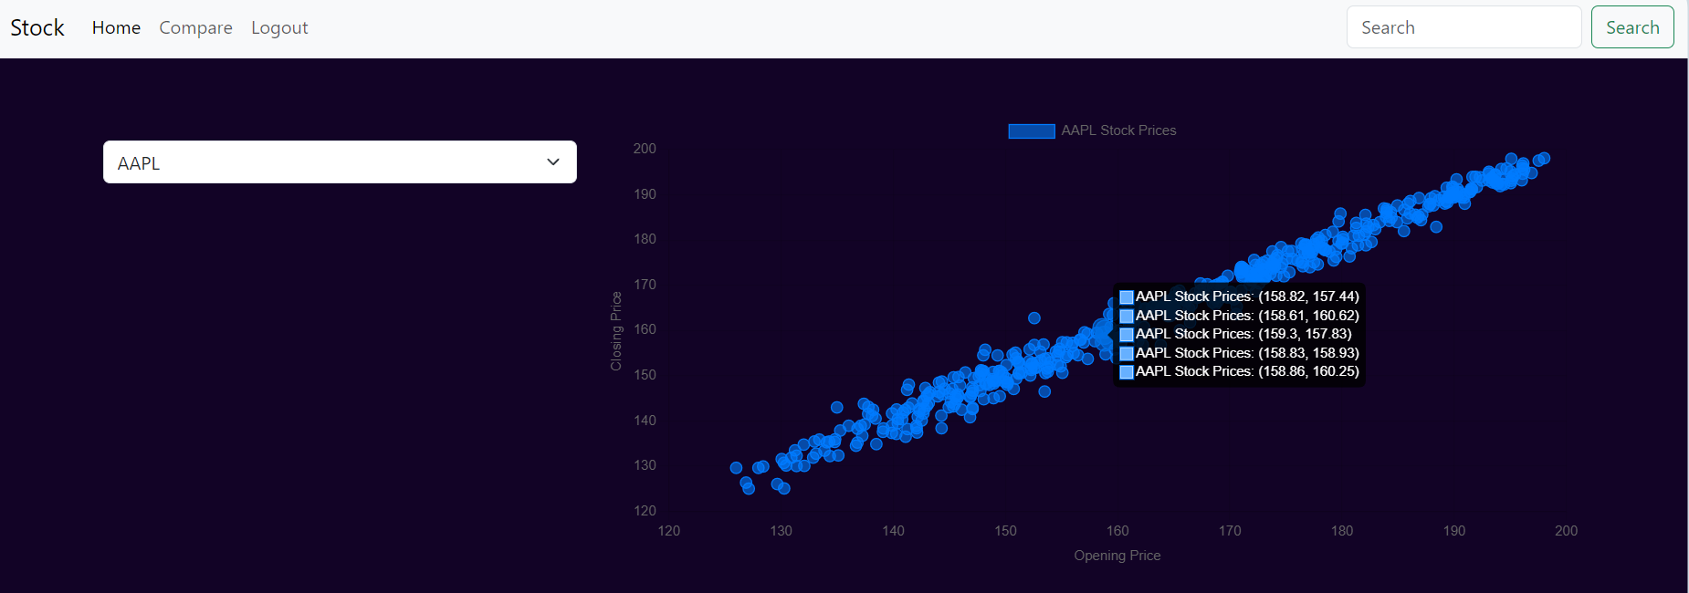
SYSTEM DESIGN AND USER INTERFACE

Slide 11
Thank you
Module Name : Machine Learning
Module Code : BCC628
Student Name : Mathumitha Kamalanathan
student id( Solent id) : 102162598

